Slide 1
XERO Application (Team 3)
Team 3 (Fall 2025):
Deepesh Katudia (QA Manager)
Ayush Gehlot (QA Analyst)
Parth Desai (Business Analyst)
Kiran Rathod (Software Tester)
Swatej Mella (Software Tester/Tableau Lead)

Slide 2
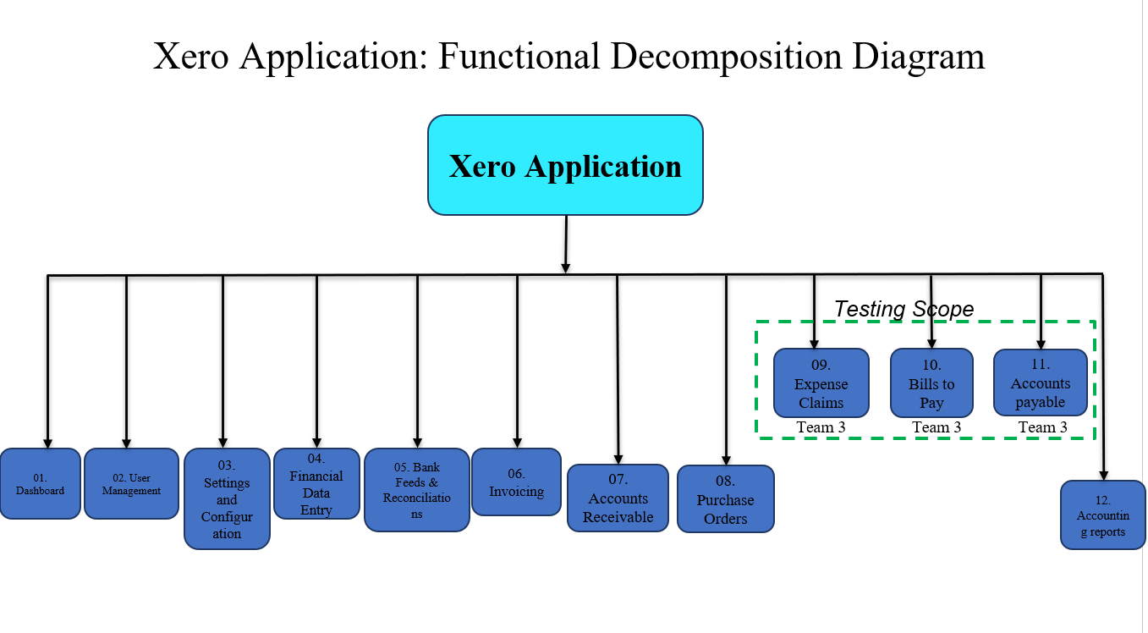
Functional Decomposition Diagram (Swatej Mella)

Slide 3
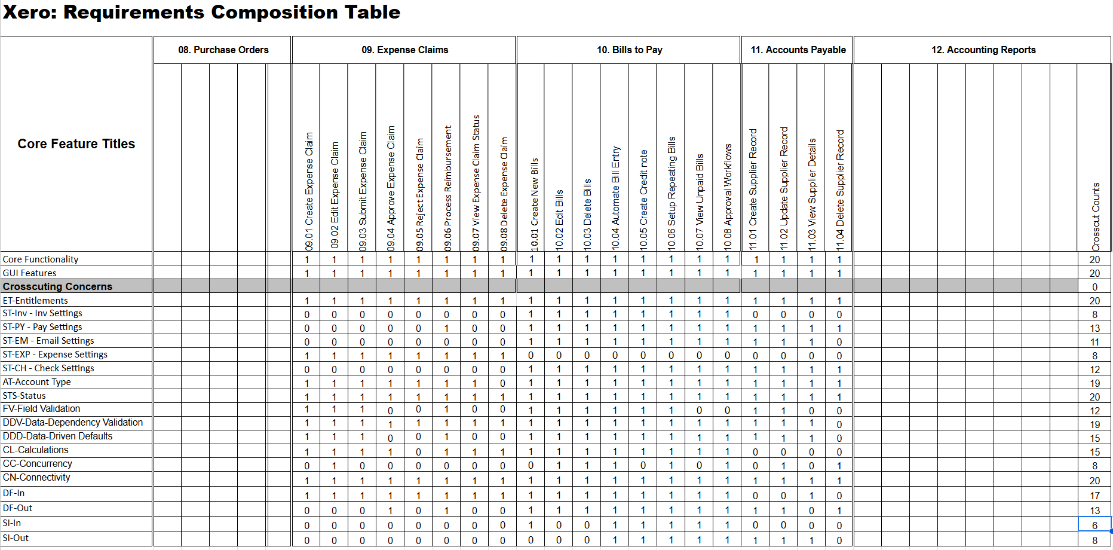
Requirements Composition Table (Kiran Rathod)

Slide 4
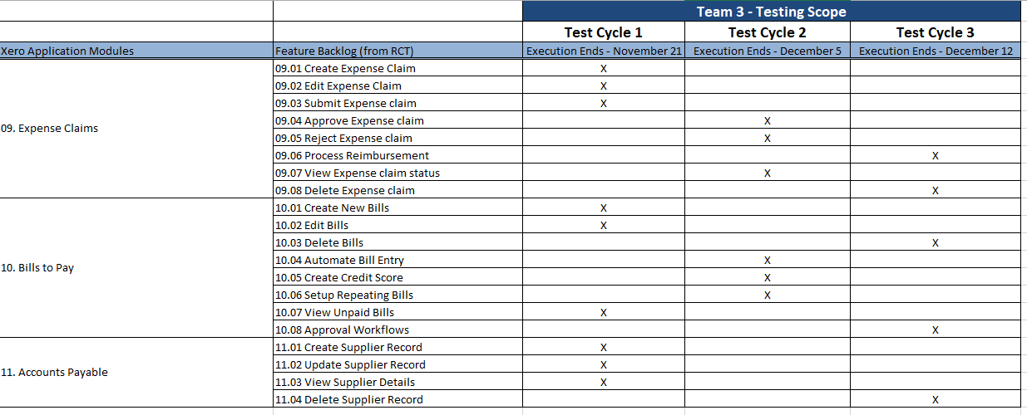
Testing RoadMap (Kiran Rathod)

Slide 5
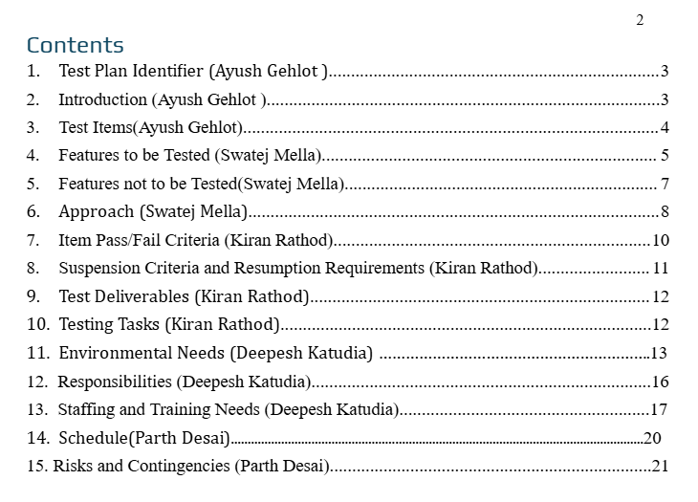
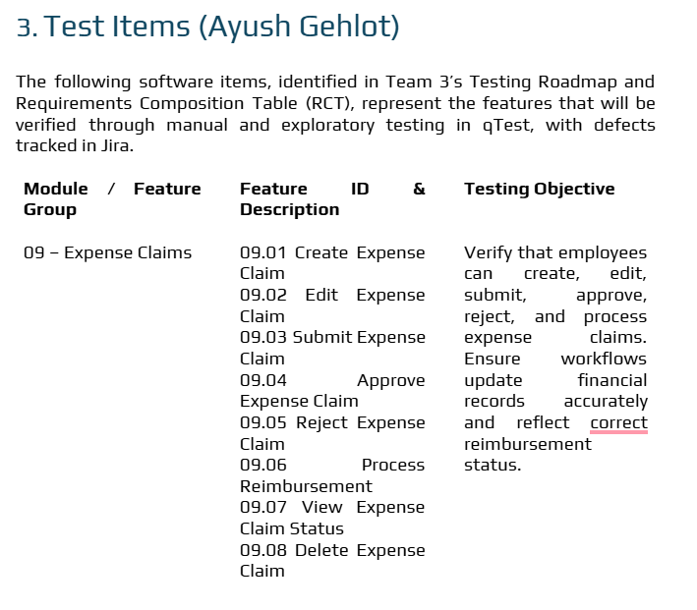
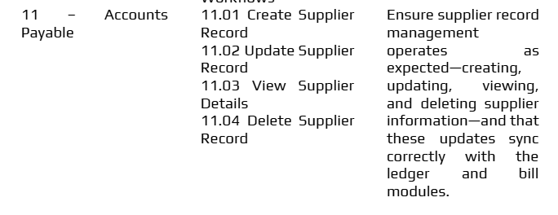
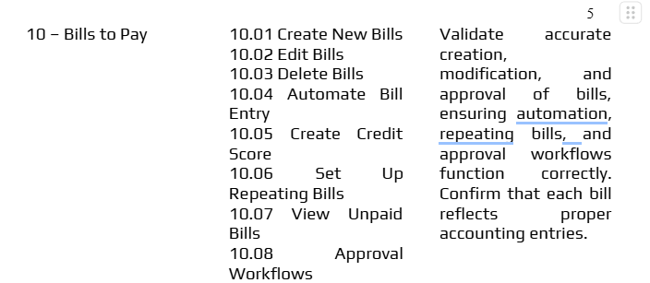
Test Plan (Ayush Gehlot)

Slide 6
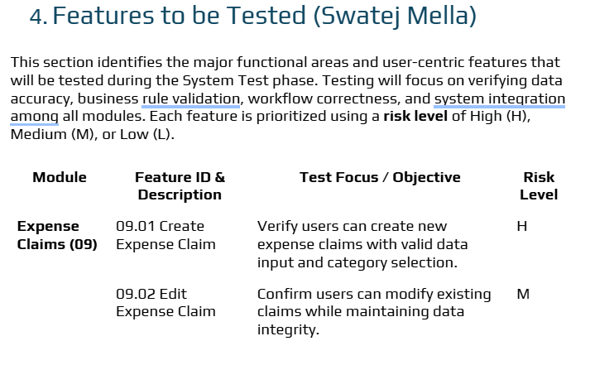
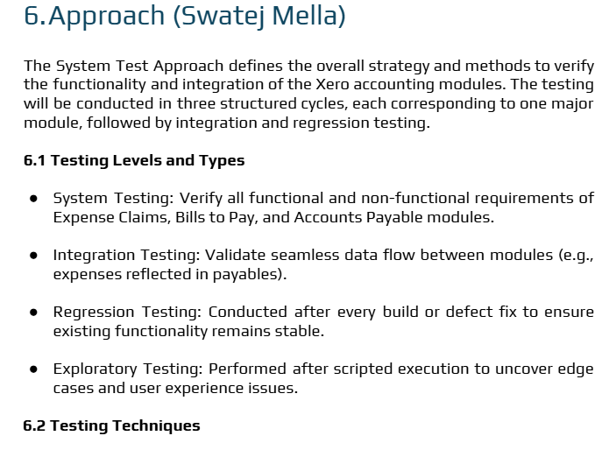
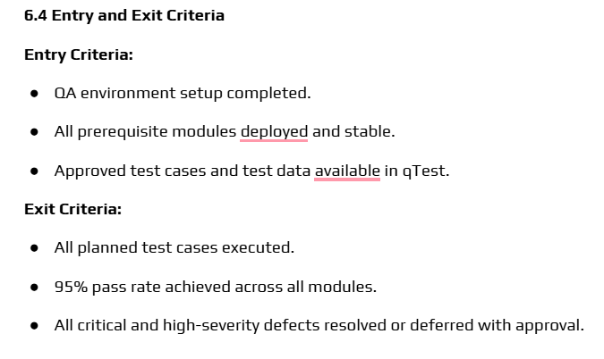
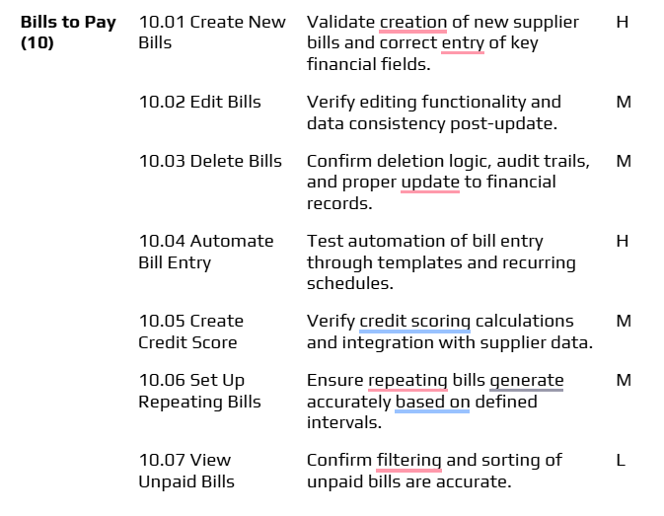
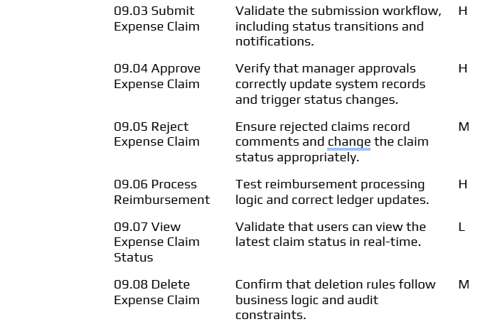
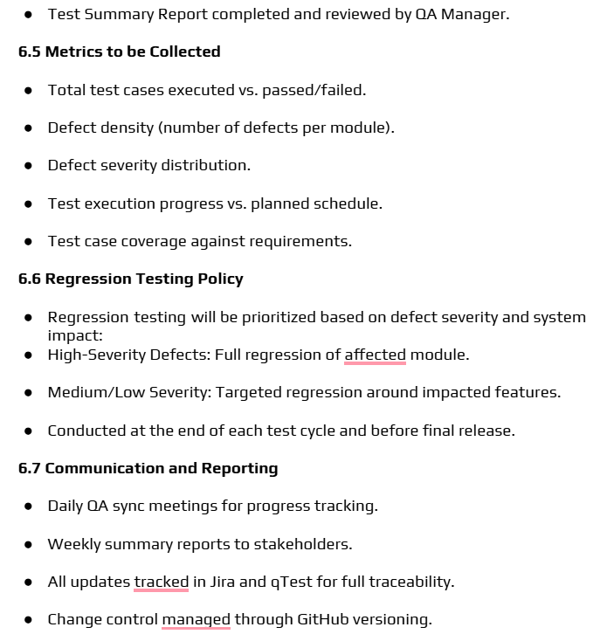
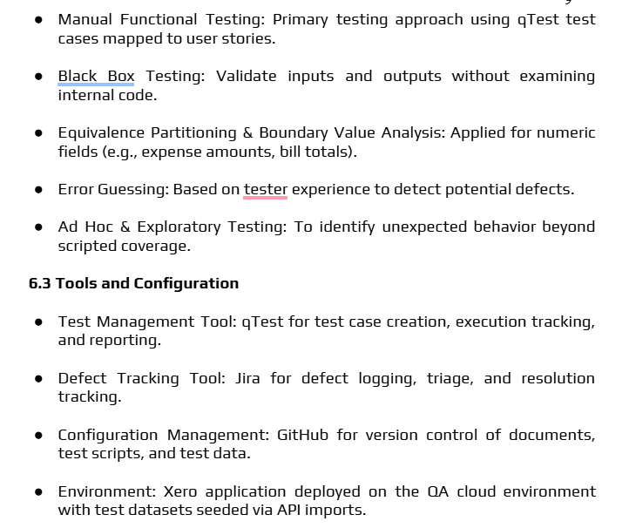
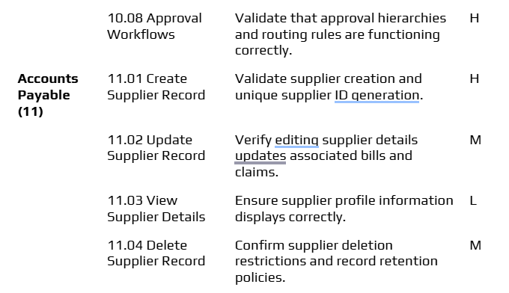
Test Plan (Ayush Gehlot)

Slide 7
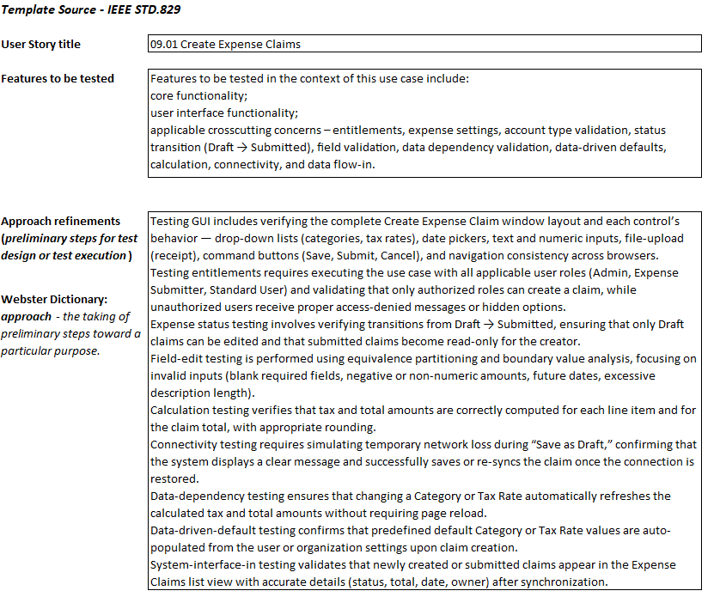
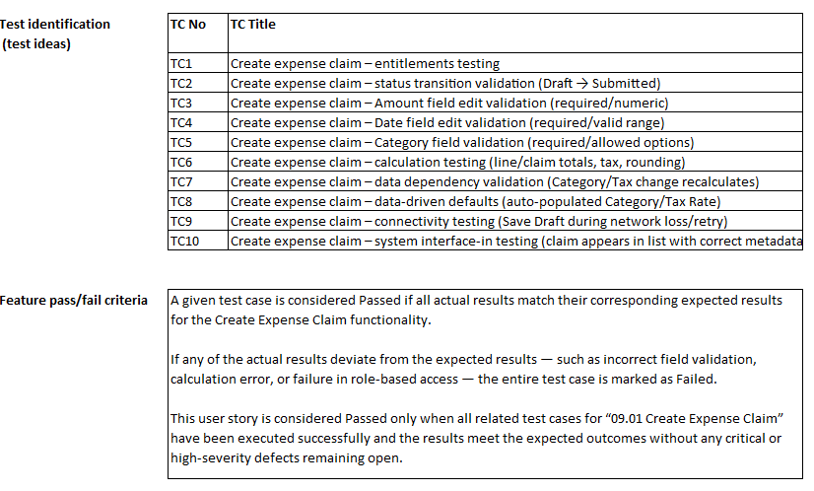
Test Design Specification (Deepesh Katudia)

Slide 8
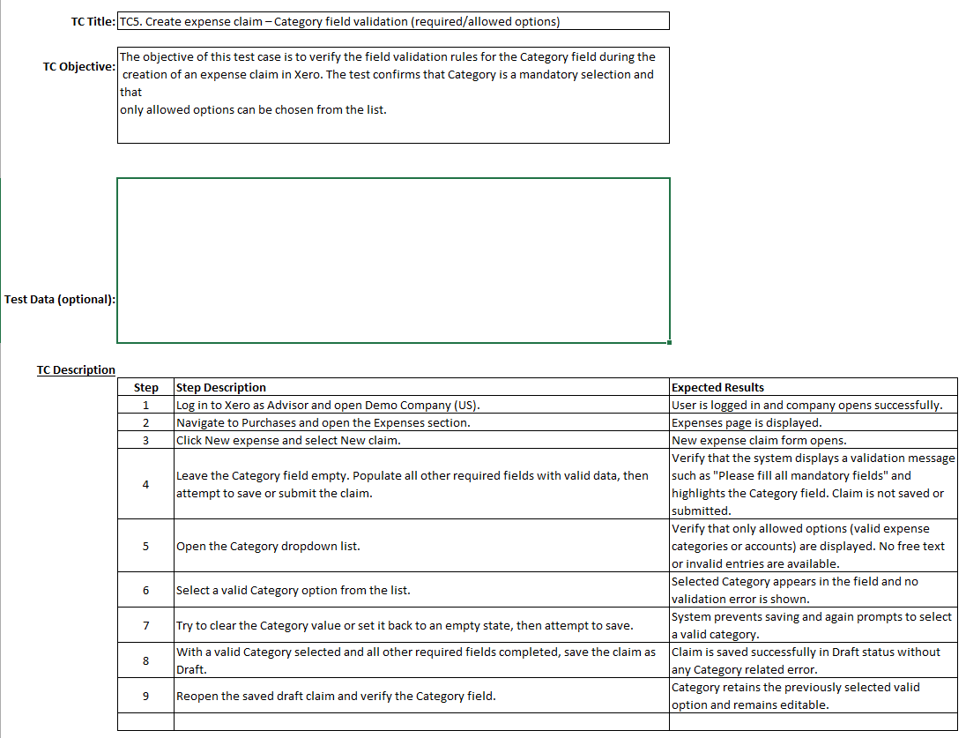
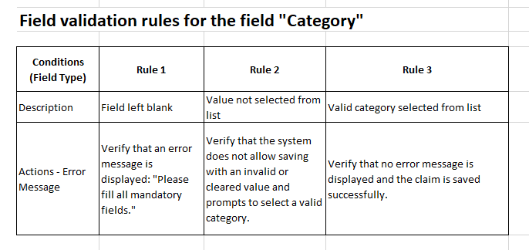
Test Case Specification (Deepesh Katudia)

Slide 9
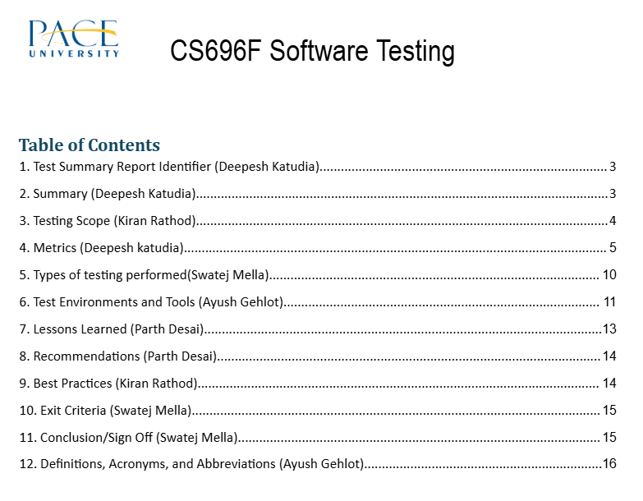
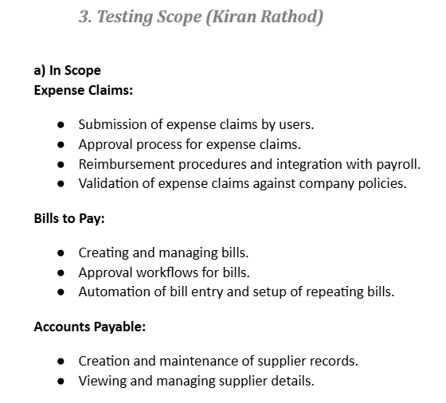
Test Summary Report (Parth Desai)

Slide 10
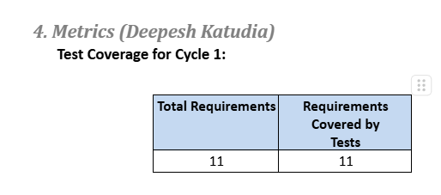
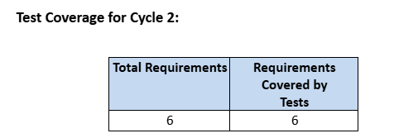
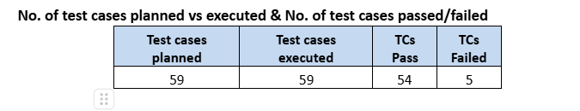
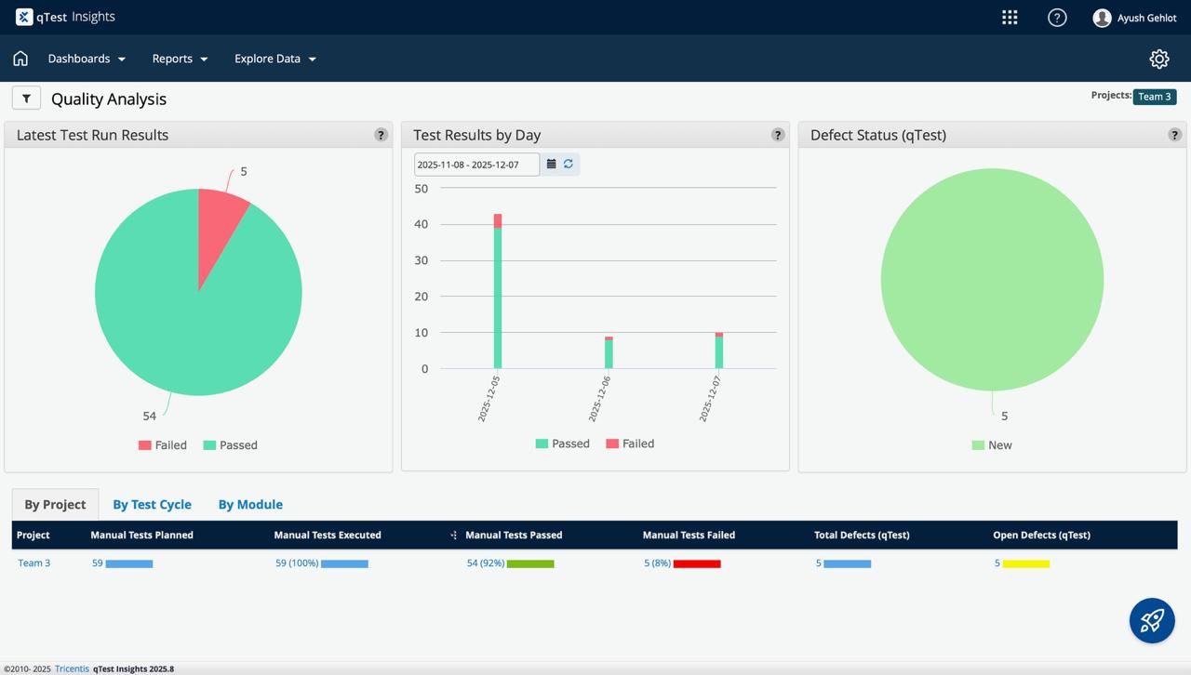
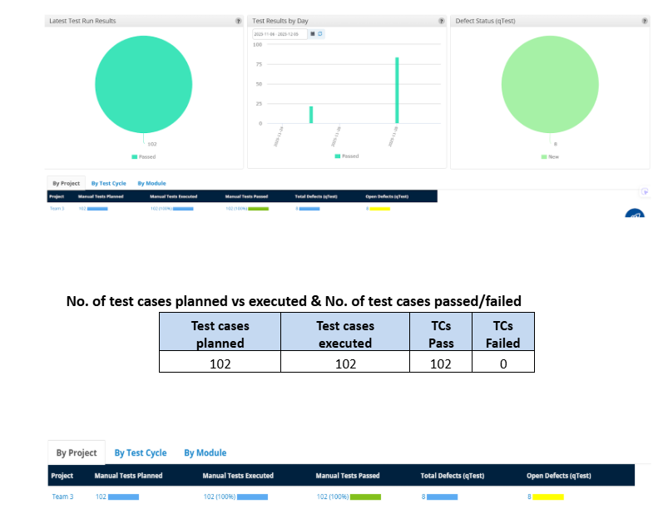
Test Summary Report (Parth Desai)
Types of testing performed
1. Functional Testing
2. Integration Testing
3. Regression Testing
4. Usability Testing
5. Validation Testing

Slide 11
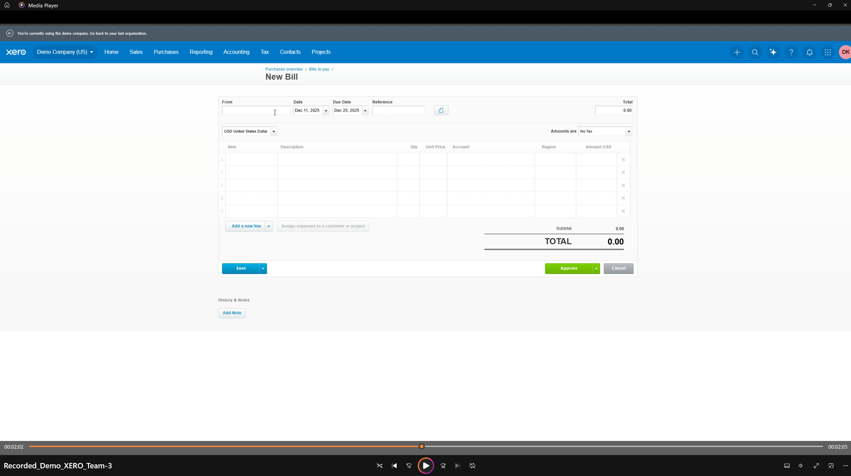
Application Recorded Demo (Parth Desai)

Slide 12

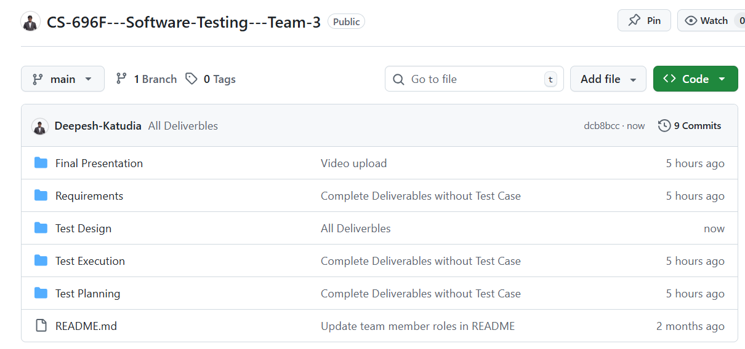
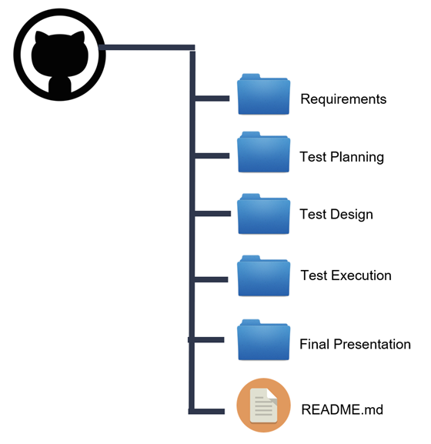
Github Repo Link (Deepesh Katudia)
https://github.com/Deepesh-Katudia/CS-696F---Software-Testing---Team-3
Folder Structure :

Slide 13
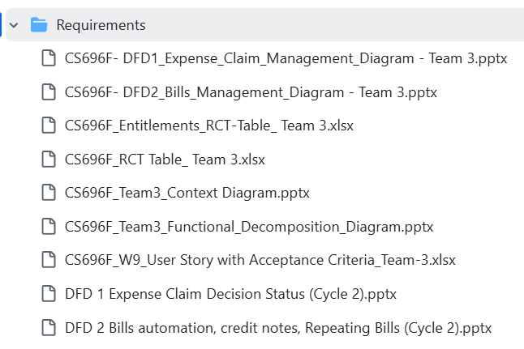
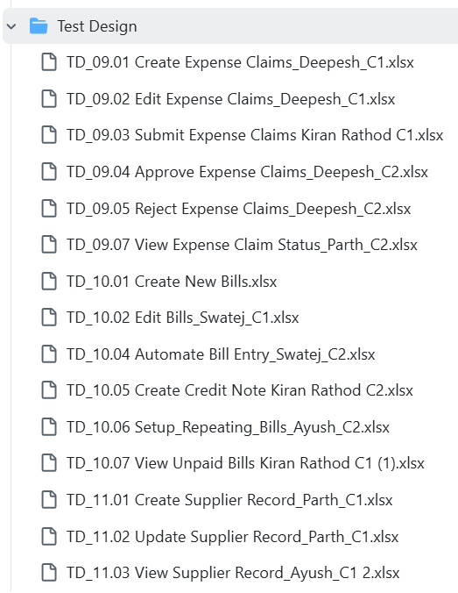
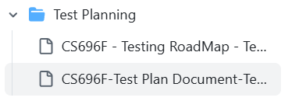
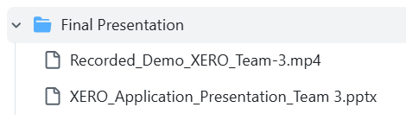
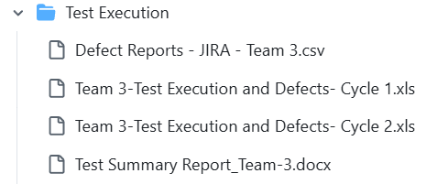
Github Folder Structure (Deepesh Katudia)

Slide 14
Thank You

